Slide 1
SENTIMENTAL ANALYSIS AND OPINION MINING FOR TAMIL TEXT
TEAM :
SANJJUSHRI VARSHINI R
PRIYADHARSHINI R
A K SUPRIYA
MADHANA LAXMI
Prof.Dr.J.VENKATESH

Slide 2
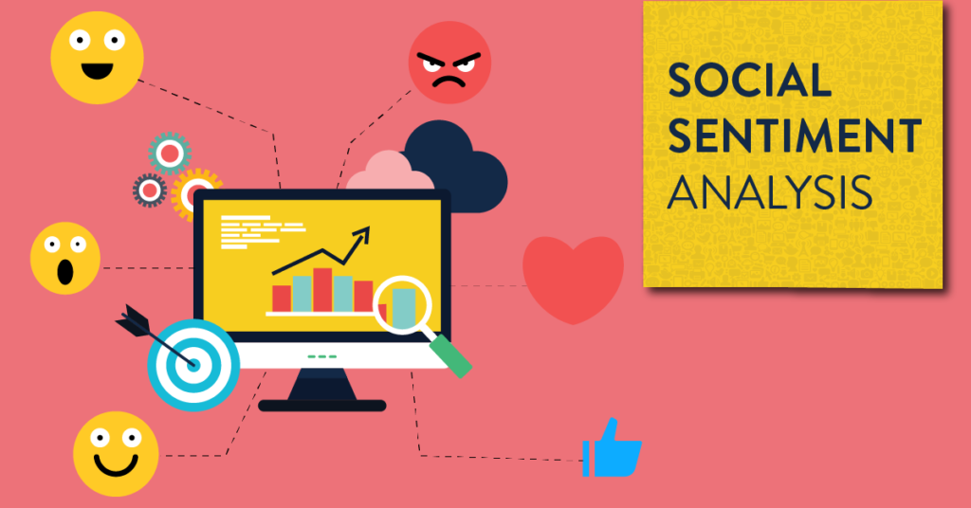
INTRODUCTION
Machine learning is a field of study that looks at using computational algorithms to turn empirical data into usable models
Natural language processing (NLP) is a field of artificial intelligence in which computers analyse, understand, and derive meaning from human language in a smart and useful way.
Sentiment analysis is contextual mining of text which identifies and extracts subjective information in source material, and helping a business to understand the social sentiment of their brand, product or service while monitoring online conversations.

Slide 3
ABSTRACT
The overall importance of sentiment analysis is connected with the development of social media such as reviews, e-commerce websites, and other social networks.
It is difficult to analyze all the reviews in another language manually, so we came up with the idea of sentiment analysis for Tamil text.
Most of the people just ignore the Tamil language reviews, we focused on it to give importance to Tamil language opinions.
Our goal is to make the job of both the seller and the consumer easier by analyzing large-scale evaluations in a matter of minutes and providing the finest product on the market.

Slide 4
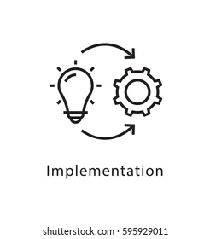
IMPLEMENTATION
We scraped data from various websites , we mainly focused on Tamil books reviews in Tamil language.
STEPS:
Data cleaning
converting the Tamil language text to integer
so that data is prepared to use
Split the data into training / test sets
Creating the model

Slide 5

Training the model
Made predictions and evaluated them and improved to get accuracy more than 0.85
Classifiers Used :
Ridge Classifier
SGD Classifier
Multinomial NB classification
Nearest Centroid
Random Forest Classifier
Support Vector Machine
Decision Tree Classifier

Slide 6
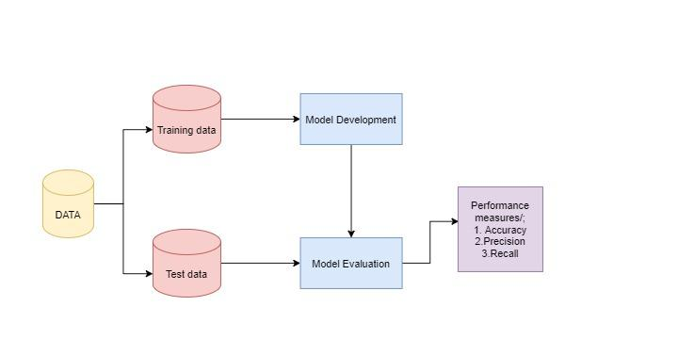
FLOWCHART

Slide 7
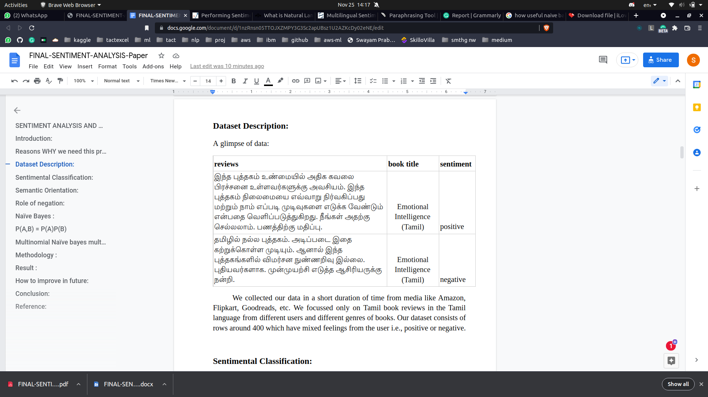
GLIMPSE OF OUR DATA

Slide 8

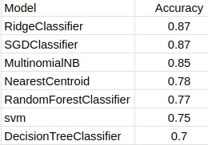
RESULT

Slide 9

FUTURE IMPROVEMENT
For efficient and successful utilization, we may extend this as an extension in the browser for consumers.
The additional study can be carried out to assess the impact of a variety of regions and domain-based elements.
Extending the use of sentiment analysis to other domains might provide some intriguing results.

